Slide 1

RheologICAL Measurements of Liquid-Solid Flows with Inertia and Particle Settling
Esperanza Linares, Melany L. Hunt, Roberto Zenit¹
Mechanical Engineering
Caltech
¹UNAM, Mexico

Slide 2
RheologICAL Measurements of Liquid-Solid Flows with Inertia and Particle Settling
Esperanza Linares, Melany L. Hunt, Roberto Zenit¹
Mechanical Engineering
Caltech
¹UNAM, Mexico

Slide 3

Rheology: suspension to a granular flow
SHEAR RATE, γ
Granular Flows
Collisional interactions
    T , P ∝ ρ_{p} d² γ²
    ρ_{p} particle density
    d particle diameter
Shear and Normal Stresses, T and P
Dilute non-colloidal suspensions
Viscous interactions
T =μ′ γ ; P ∝ γ
  μ′ - corrected viscosity,
  μ′ = μ f(φ) with φ as the
  solid fraction
We are interested in this transition.

Slide 4

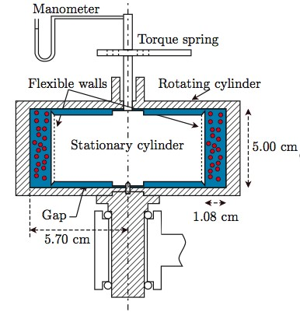
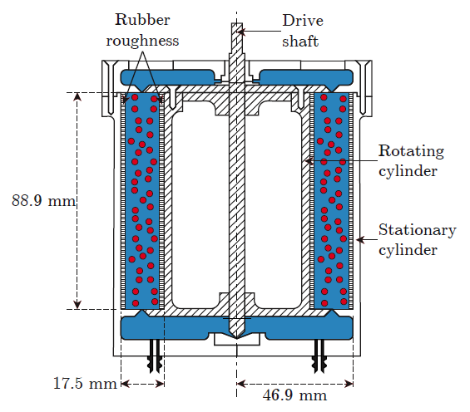
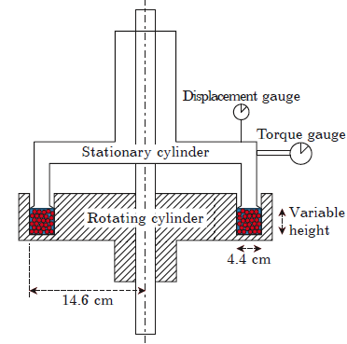
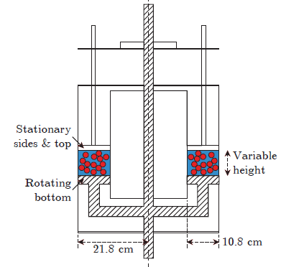
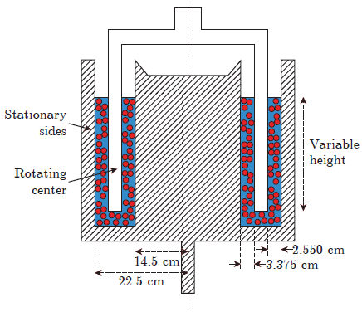
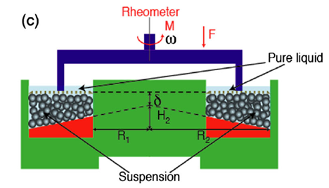
Prior studies liquid+solids
Particle diameters > 0.5 mm (except Acrivos.,)
Bagnold (1954)
Savage & McKeown (1983)
Hanes & Inman (1985)
Acrivos, Fan & Mauri (1994)
Prasad & Kytomaa (1995)
Dijksman, et al. (2010)
Boyer, Guazzelli & Pouliquen (2011)
PARAMETERS:
Particle Reynolds number, Re_{d}=ρ_{f} γ d²/μ
Solid Fraction, φ
Density ratio, ρ_{p}/ρ_{f}
Gap Reynolds number, Re_{gap}=ρ_{f} ωr_{o}(r_{o}-r_{i})/μ

Slide 5
Experiments
Koos, Linares, Hunt, Brennen 2012
Hanes & Inman 1985
Bagnold 1954, “macroviscous”
Re=ρ_{f} d²γ /μ
Prasad & Kytomaa 1995
Dijksman, et al 2010
Boyer, Guazzelli & Pouliquen 2011
Acrivos, Fan, Mauri 1994

Slide 6
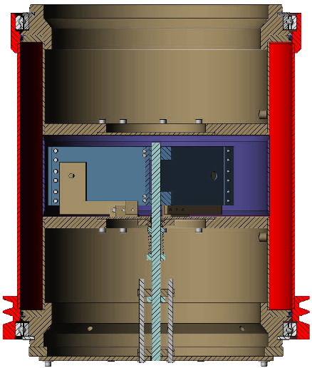
Our rheometer
outer rotating
cylinder
inner stationary cylinder
fluid and particles in annular gap
37 cm
Torque measured in central section
Guard cylinders
Optical probes
Koos, Linares, Hunt, Brennen, Physics Fluids, 2012
3 cm
19 cm
Notes:
outer rotating concentric cylinder Couette flow rheometer

Slide 7
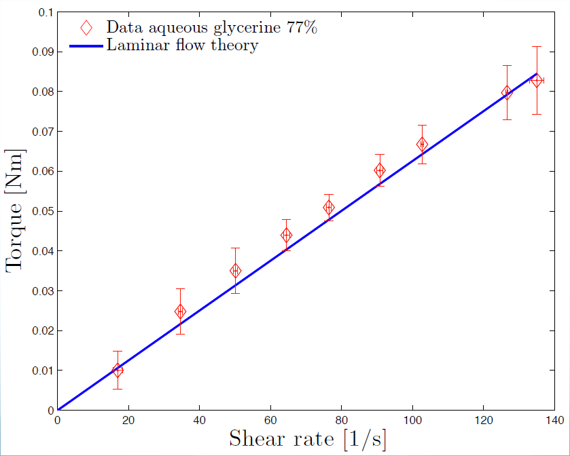
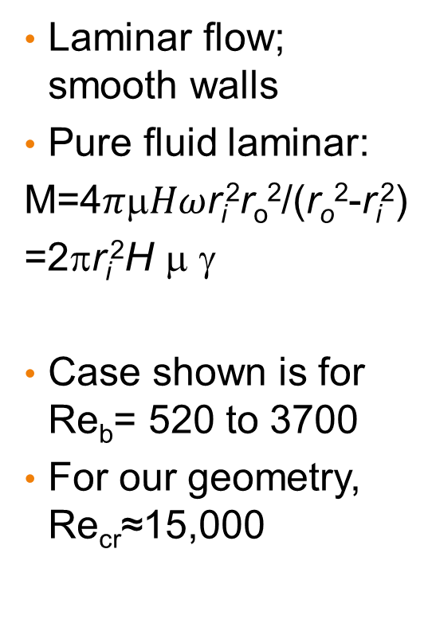
Our pure fluid tests
Laminar flow; smooth walls
Pure fluid laminar:
M=4$πHω$r_{i}²r_{o}²/(r_{o}²-r_{i}²)
=2πr_{i}²H $$ γ
Case shown is for Re_{b}= 520 to 3700
For our geometry, Re_{cr}≈15,000

Slide 8
Flows with ρ_{p} ≈ ρ_{f} and smooth walls
3.3-mm polystryrene cylindrical particles
φ=0.4
φ=0.3
Torque
Koos, et al, PF, 2012
St = ρ_{p}d²γ / (9μ)

Slide 9
Results for flows with ρ_{p} ≈ ρ_{f} and smooth walls
3.3-mm polystryrene cylindrical particles
Non-dimensional Torque
φ=0.4
φ=0.3
Koos, et al, PF, 2012
St = ρ_{p}d²γ / (9μ)

Slide 10
Results: different particles with ρ_{p} ≈ ρ_{f} and smooth walls; Bagnold macro-viscous data
φ_{l} is random loose pack solid fraction
Nylon spheres 6.4 mm diameter: φ_{l} =0.57
SAN spheres 3.2 mm diameter
φ_{l} =0.61
Polystyrene cylinders 3.3 mm:
φ_{l} =0.55
Koos, et al, PF, 2012

Slide 11
Results for smooth & rough walls
Settling particles
Difference is slip
Rough
Smooth
Correlation for low-Re suspensions studies, such as Acrivos, et al & Boyer, et al

Slide 12
Neutrally-buoyant experiments
Koos, Linares, Hunt, Brennen 2012
Bagnold 1954, “macroviscous”
Current work; rough walls
Boyer, Guazzelli & Pouliquen 2011
Acrivos, Fan, Mauri 1994
Re=ρ_{f}d²γ/μ

Slide 13
Neutrally-buoyant experiments + simulations
Koos, Linares, Hunt, Brennen 2012
Bagnold 1954, “macroviscous”
Simulations:
Kulkarni & Morris 2008
Yeo & Maxey 2013
Picano, et al 2013
Current work; rough walls
Boyer, Guazzelli & Pouliquen 2011
Acrivos, Fan, Mauri 1994
Re=ρ_{f}d²γ/μ

Slide 14
Effective viscosity
Particle contribution to stress = sum stress over all particles +
stress due to particle acceleration + Reynolds stress
Simulations
Kulkarni & Morris 2008;
Yeo & Maxey 2013;
Picano, et al 2013
Re_{d}=ργd²/μ
Eiler: μ_{eff}/μ=[1+1.25*φ/(1-φ/φ_{m})]²

Slide 15
Neutrally-buoyant; rough walls
3 mm Polystyrene; alcohol-glycerine;
ρ_{p}=ρ_{f}

Slide 16
Neutrally-buoyant; rough walls
Polystyrene; glycerol + alcohol
Picano, et al, 2013

Slide 17
Neutrally-buoyant; rough walls
3 mm Polystyrene; water-glycerol

Slide 18
Neutrally buoyant
Alcohol glycerine
Water glycerine

Slide 19
Transition to turbulence; pure fluid
rough
smooth
turbulent
laminar
Alcohol glycerine
Water glycerine

Slide 20
Turbulent
G=T/(Hρν²); G=A Re^{α}
α=1 laminar; α=1.75 turbulent Re>4000 (Ravelet , et al 2010)
α=1.68; pure fluid

Slide 21
Torque normalized by torque turbulent

Slide 22
With particle settling
Replace inner cylinder clear cylinder to visualize expansion as the flow is sheared from outer cylinder

Slide 23
Summary
Re_{d}>1, inertial contribution to the effective viscosity that depends on Reynolds number
Re_{gap}>Re_{cr}, turbulence & particle contribution and perhaps μ_{eff}=μ_{turb}f(φ) at lowest solid fraction
Particle settling – complicates the flow
Collisions: St>20
  Single particle collisions in a liquid

Slide 24
Questions?

